Slide 1



Agentic Era Hackathon - FinAgentX
Problem Statement
Input Channel, e.g. FSCM
BAI2 Bank
Statement
Bank
SAP System
BAI2 files are csv files which need to comply with a specification
Not all files meet the specification, which can lead to problems and impact customer business
The potential error space is huge, so traditional check logic has limits
Currently analysis is cumbersome in case of errors

Slide 2

Agentic Era Hackathon - FinAgentX
FinAgentX – a multi agent system
Input Channel, e.g. FSCM
BAI2 Bank
Statement
Bank
SAP System
The input channel calls the Validation Agent, checks the file consistency versus the technical specification, based on a prompt and records
Reporting agent can read out past validations and provide information
Notification Agent will inform end users on configured channels
FinAgentX
Validation
Agent
Reporting
Agent
Notification
Agent

Slide 3
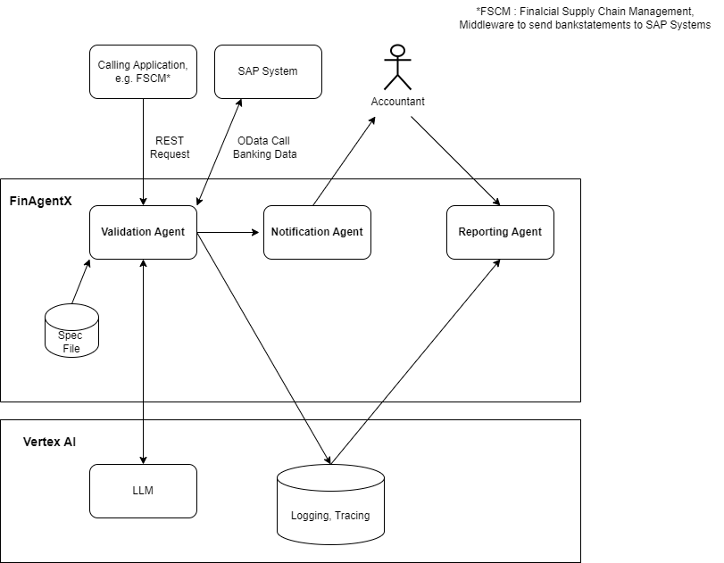
Agentic Era Hackathon - FinAgentX
Architecture Overview

